Slide 1
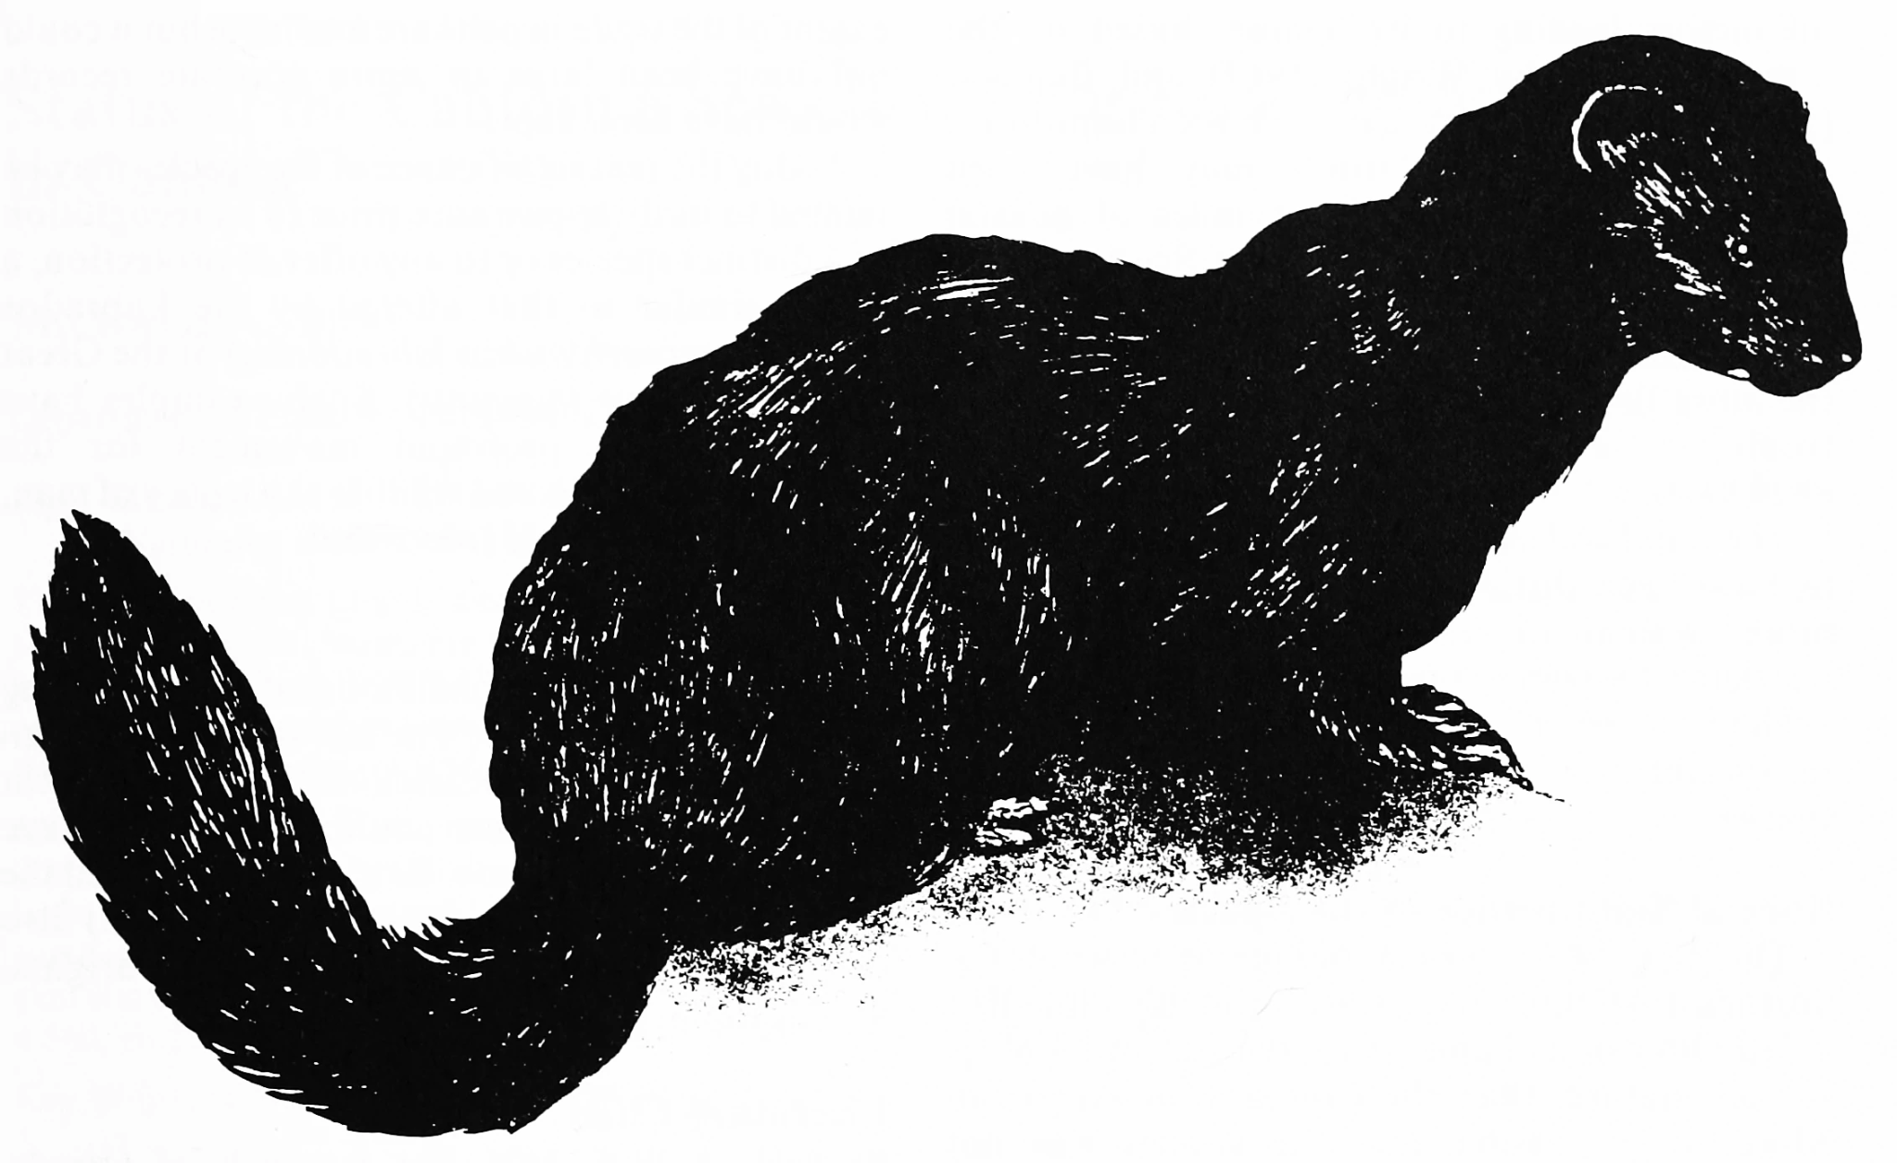
Sea Mink
Supeqi-ciyahkehs

Slide 2
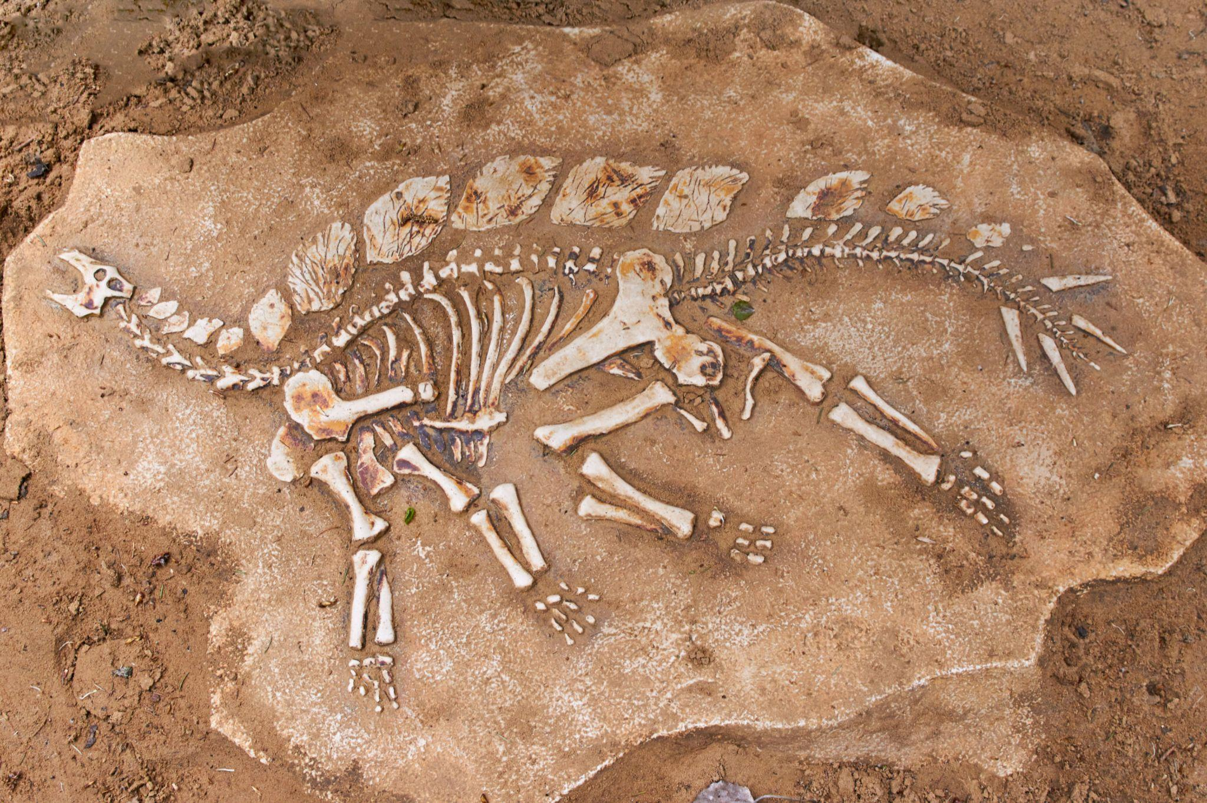
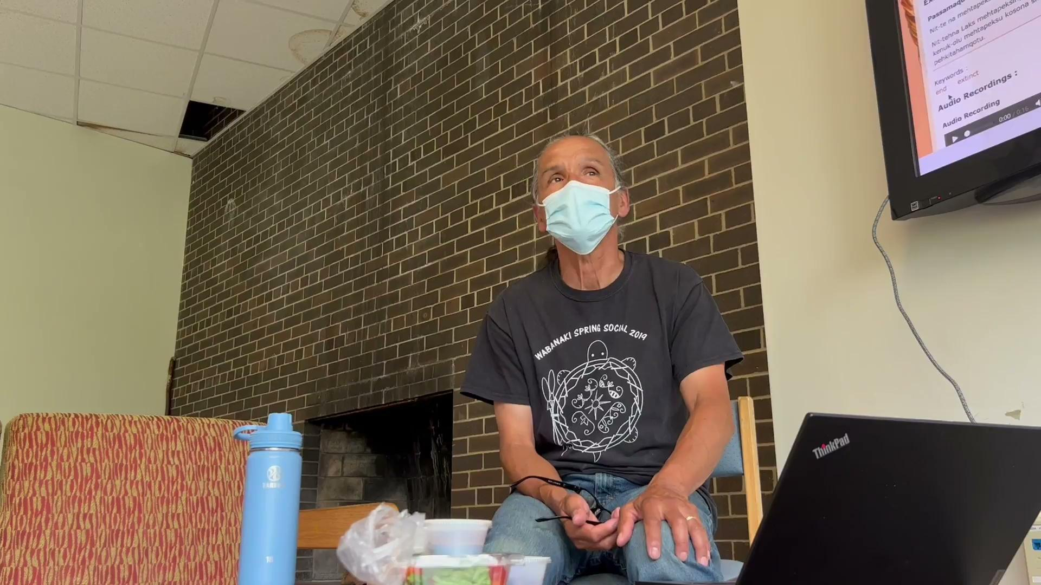
Extinct
(Passamaquoddy Audio)
(English Audio)
Dinosaur Fossil
English: “The Sea Mink is Extinct”
Passamaquoddy: “Mehtapeksit Supeqi-ciyahkeysuwok”
“The Sea Mink is extinct”

Slide 3
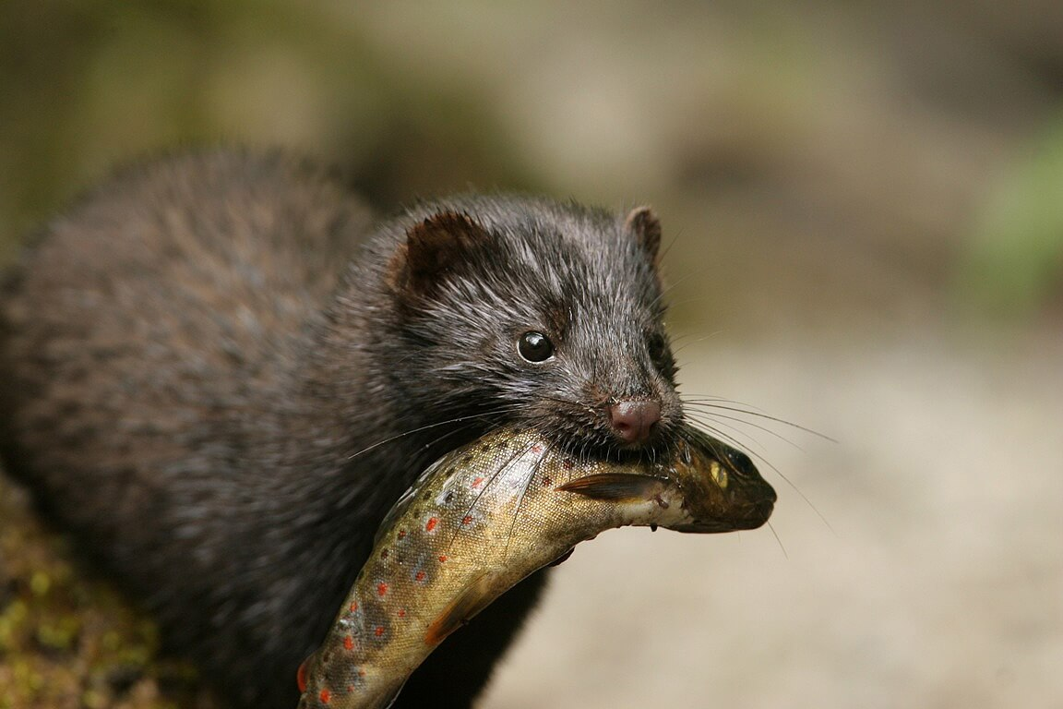
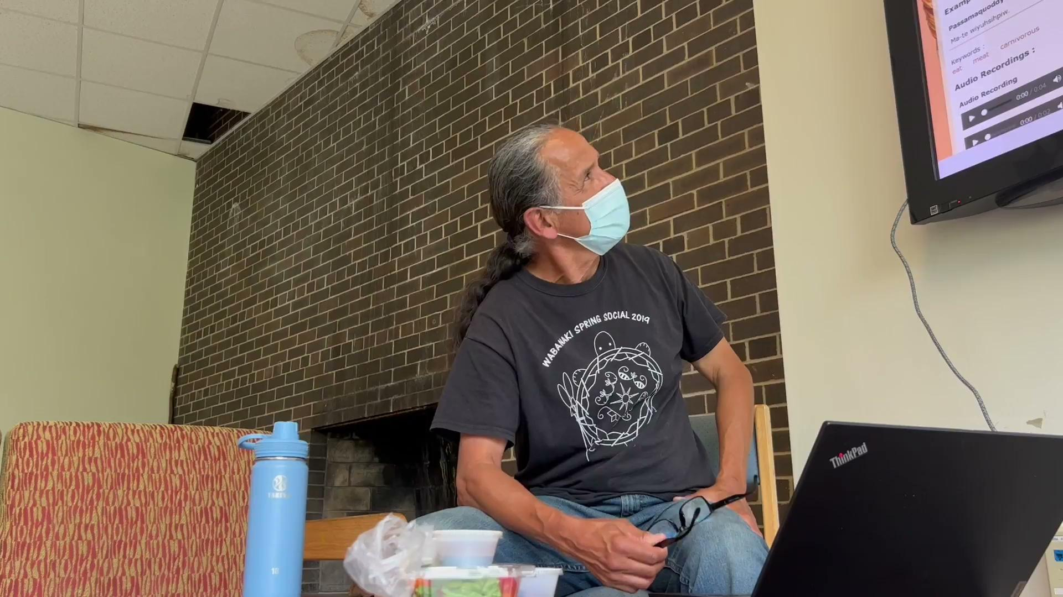
Carnivore
(English Audio)
(Passamaquoddy Audio)
Sea mink eating a fish
English: “The sea mink is a carnivore”
Passamaquoddy: “Wiyuhsipid supeqi-ciyahkeys”

Slide 4
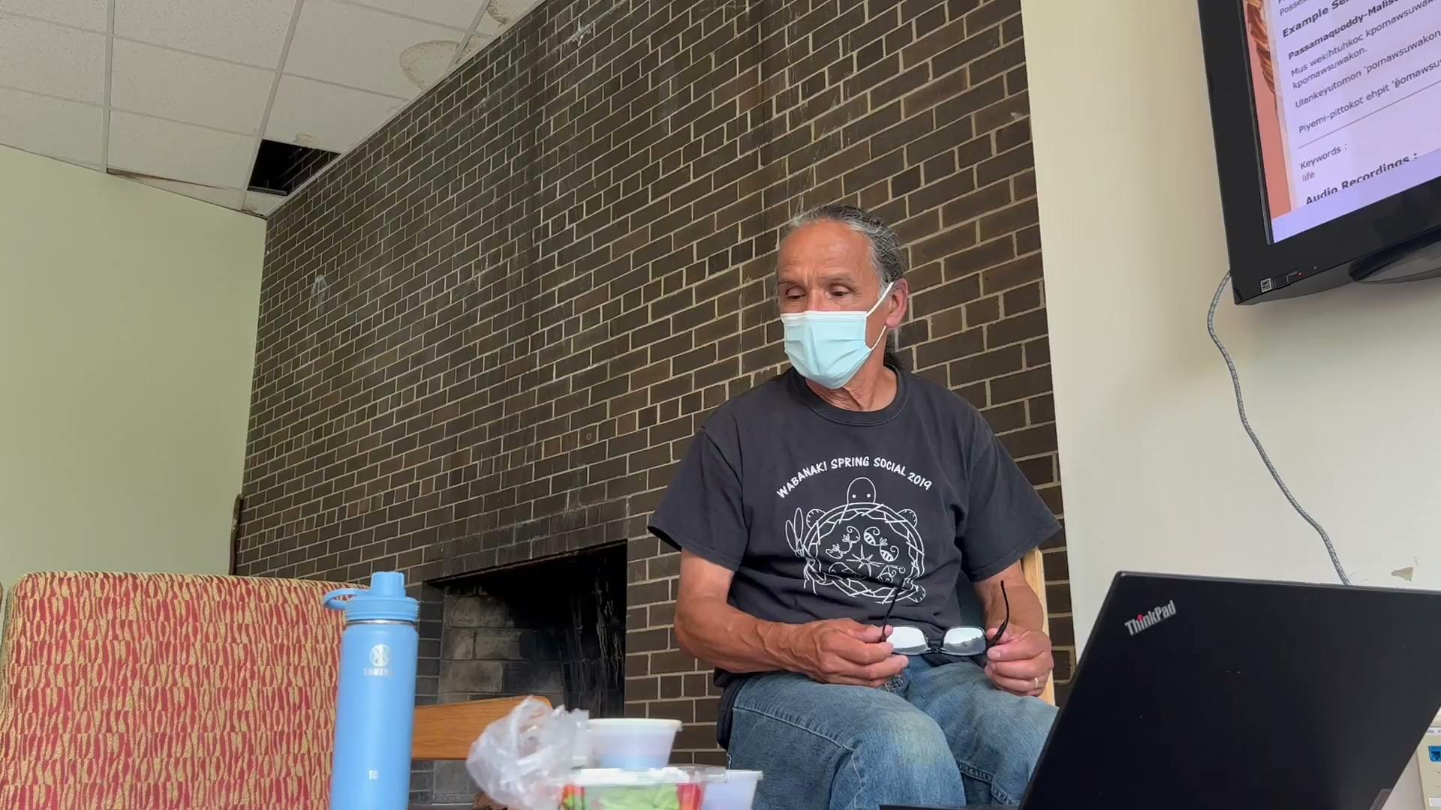
Lifespan
(English Audio)
(Passamaquoddy Audio)
English: “How long is life”
Passamaquoddy: “Tan kesholu pomaswuwakonol ”

Slide 5
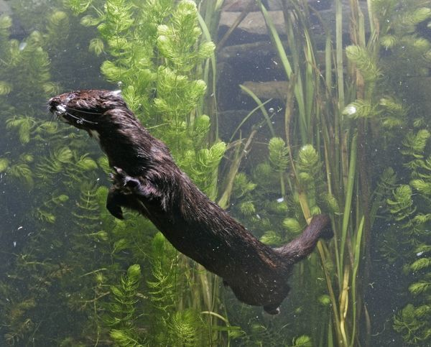
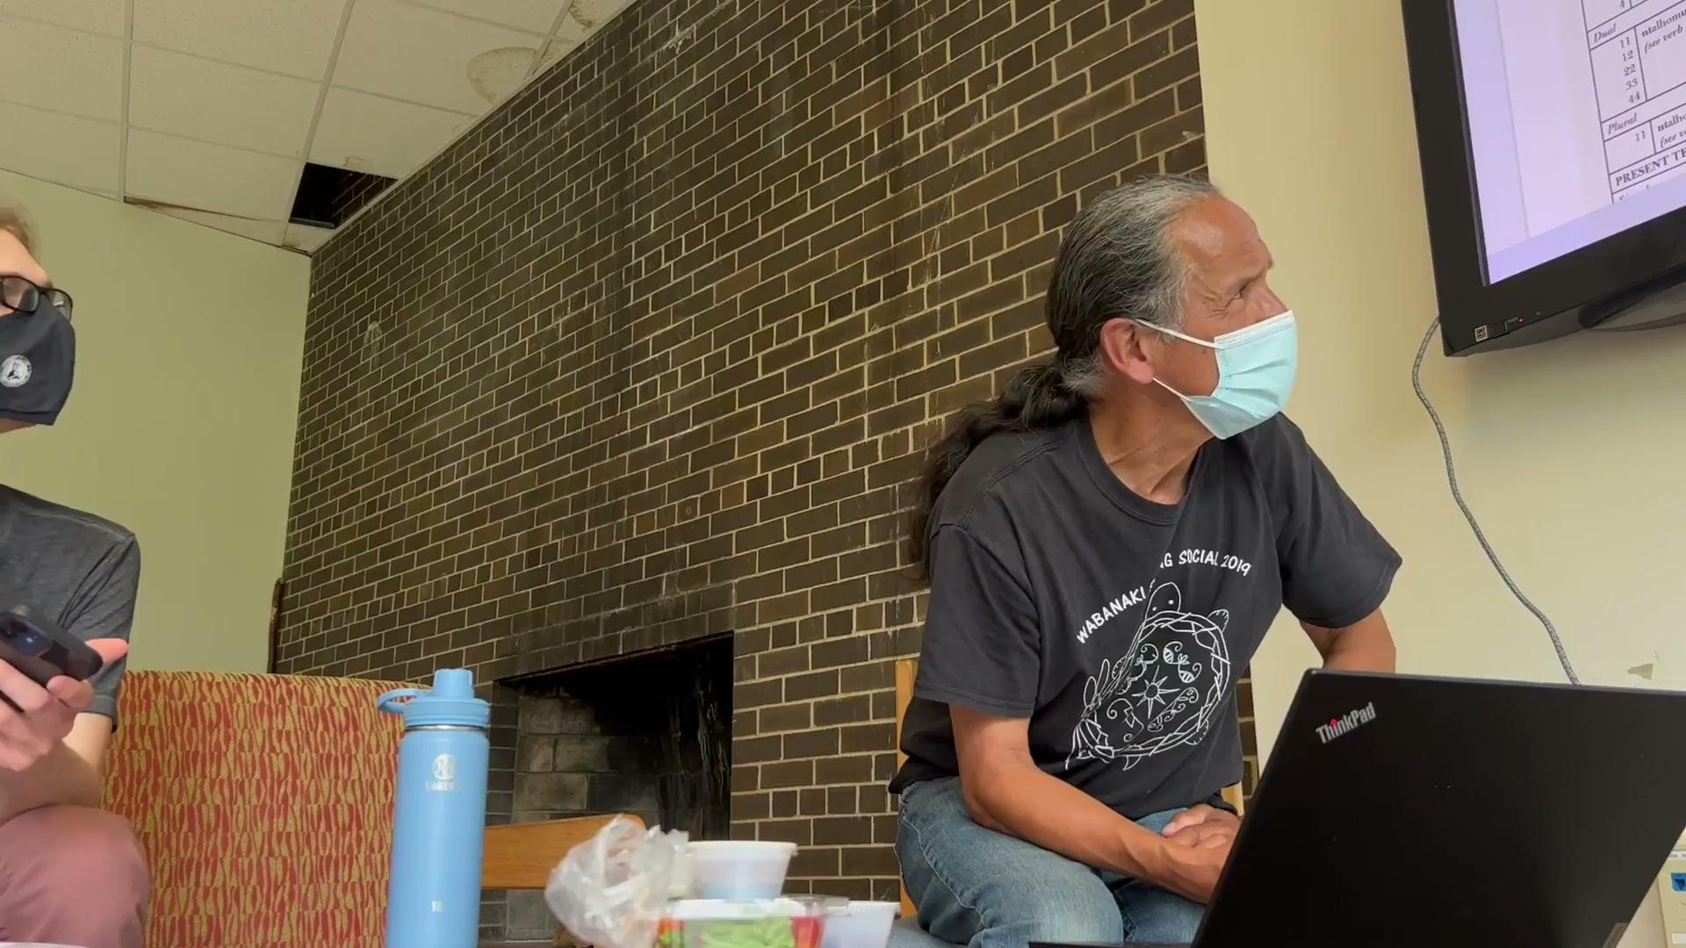
They Swim
(English Audio)
(Passamaquoddy Audio)
Sea mink swimming
English: “Sea mink swim”
Passamaquoddy: “Supeqi-ciyahkeysuwok alhomuhtiyek”

Slide 6
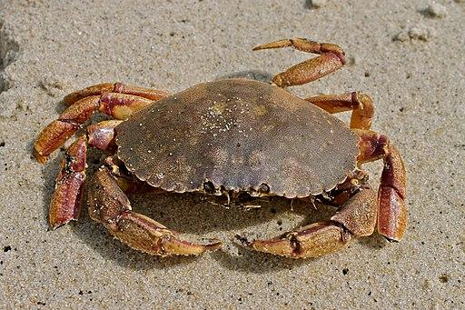
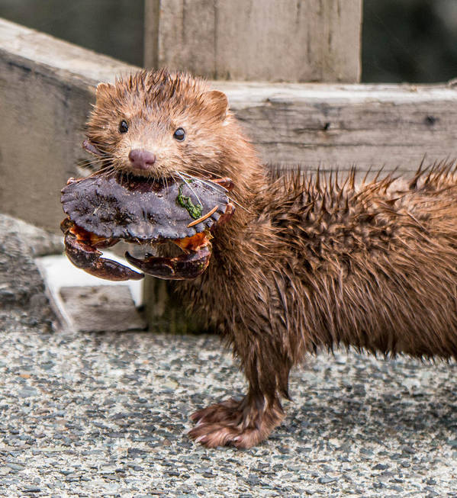
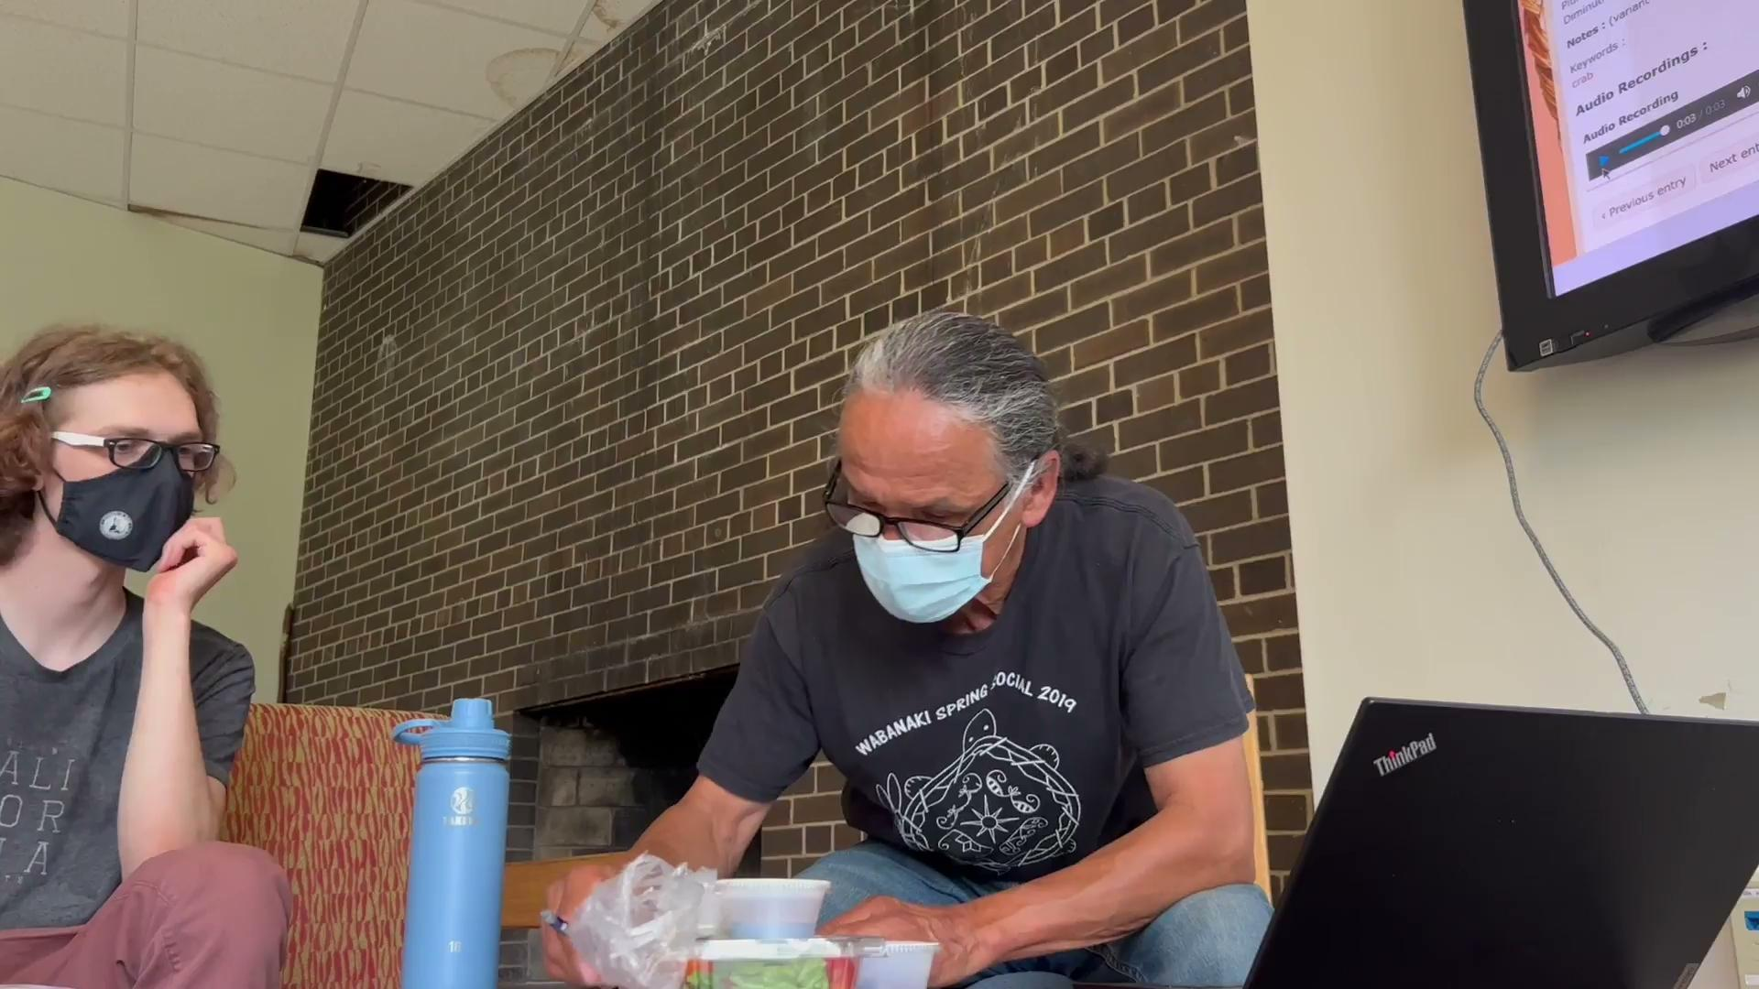
Crabs
(Passamaquoddy Audio)
(English Audio)
Rock Crab
Sea mink eating a crab
English: “Sea mink eat crabs”
Passamaquoddy: “Supeqi-ciyahkeysuwok mahahniya nomociniihsehsuwok”

